Slide 1
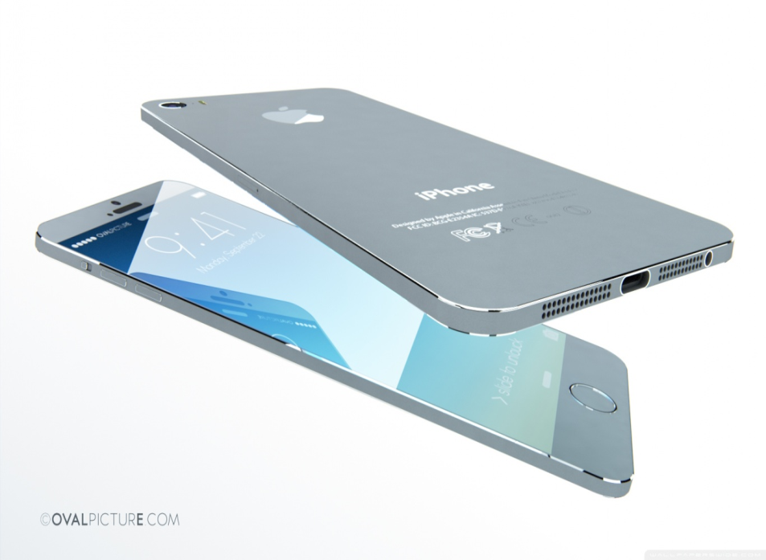


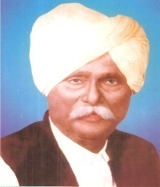
DADA PATIL MAHAVIDYALAYA, KARJAT
[ Re – accredited ‘B’ Grade by NAAC with CGPA 2.83 ]
WELCOME TO
DEPARMENT OF COMPUTER SCIENCE
atuljadhavbcs@gmail.com

Slide 2
Introduction to system:-
To many people, the term “electronic commerce” means shopping on the part of the internet called the World Wide Web. Actually, electronic commerce (or e-commerce) also included activities like businesses trading with other businesses and internal processes that companies use to support their buying, hiring, planning and so on.
The project is aimed at developing a web application that describe the online shopping of cake and gifts. Online shopping is the one of the application to improve the marketing company product.
Cake and gift order system aims to accelerate customer orders. The main principle behind the need of cake and gift order system is easy to understand the menu and some links. It’s has user friendly and modular approach. The modular approach of the software increases the flexibility of the software. Date storing is easier. Paper word is the reduced. The record of each customer is stored that is customer’s name, contact details and some other information.

Slide 3
SCOP OF THE SYSTEM:-
Users can order the cake and gift without visiting the bakery or sweet hotels.
Users from any location can order the cake and gift by looking at the cake and gift items and pay in advance or at the time of delivery.
Save users time.
The online cake and gift order system will be helpful for the bakery or sweet hotels to increase the scope of the business by helping users to give order through online.
The main aim’s is to simplify and improve the efficiency of the ordering process for both customer and bakery or sweet hotels, “Excellent client service”.

Slide 4
EXISTING SYSTEM:-
Reports are prepared manually as and when needed maintain of reports is very tedious task.
In the existing system all transaction dealing of products purchasing of products were manually which is time consuming.
To buy are product’s user has to collects information either by visiting the shop or asking which is the better one.
PROPOSED SYSTEM:-
Shop online is the online application which provides the online shopping facility available for everyone.
Shop online application concentrates more on user friendly interface and promotes. User to purchase faster and easier.
Security issue pay’s major important today extra attention to word’s security is done in shopping applications.
It Provide the customer support page.

Slide 5
Feasibility Study:-
Feasibility is the process of planning to develop system or improving an existing system. The purpose of feasibility study is to develop a selection criterion, a selection procedure and effective decision making organization such company can be certain. It is working on right problem and in the right sequence.
Depending on the result of the initial investigation, the survey is expanded to a more detailed feasibility study.
Technical Feasibility:-
In technical feasibility, the user can write, read and can change stored data and proposal may be technically feasible. In this we can work for the project is done with current equipment. Existing software technology and available personal, if new technology is required what is the like hood that it can be developed.

Slide 6
Economical Feasibility:-
In Economical feasibility, economically the software cost less and there are more gains by using the computer system, because the other extra resources are not required like scanner, printer etc.
There are sufficient benefits in creating the system to make the cost acceptable.
Operational feasibility:-
Operational feasibility means considering whether it is feasibility to operate the system is our organization environment.
In operational feasibility, the interaction with software is very user friendly and accessing speed is faster.

Slide 7
Fact Finding Technique:-
To study the system we need to collect facts i.e. gathering information about the system. The proper use of tools for gathering information is the key to success analysis.
We used the following Fact Finding Technique:
Observation
Observation:-
Observation allows analyst to gain information they can’t from any other fact-finding techniques. In this method analyst observes the flow of documents, way the process is carried out etc.

Slide 8
Software & Hardware Requirement:-
To run system it requires the following Operating System Environment.
Machine capability:-
Processor: Intel Core i3 and above
RAM: 4GB
Hard Disk: 500GB
Software required:-
PHP
My SQL

Slide 9
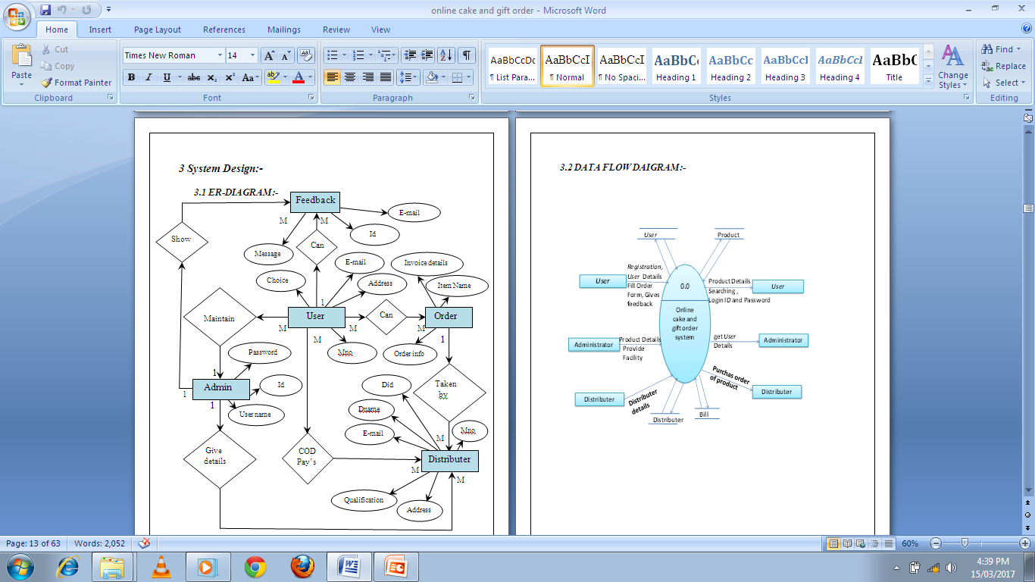

Slide 10
DATA FLOW DAIGRAM:-

Slide 11
First level DFD [ level 1.0 ]

Slide 12
Second level DFD [ level 2.0 ]

Slide 13
Third level DFD [ level 3.0 ]

Slide 14
UML DIAGRAM:-
1) CLASS DIAGRAM:-
Admin
Distributer
wholesaler
# Name: name
1
has
1...*
# name:name
# Password:String
# Name: name
# ID:number
# Phone: number
# ID: number
# phone:number
# Phone: number
# address:string
# Address: string
+add Distri()
1...*
+add Distributer ()
+delete Supplier ()
+addwhloesaler()
+add User ()
+deletewhloesaler()
+delete Distributer ()
+delete User ()
+getwholesaler()
+get Distributer ()
+get product ()
+getallwhloesaler()
+get User()
1...*
Buy product
Member
1...*
*
User
Productt
Saler
# Name: name
Purchase
# Name: name
Service
# Address: string
# ID: number
# Phone: number
*
*
# Rate: number
*
1
# Quantity
+get Details ()
+get product ()
1
1...*
Feedback
# Name: name
#Email: email
#Message:Msg
+get Details ()

Slide 15
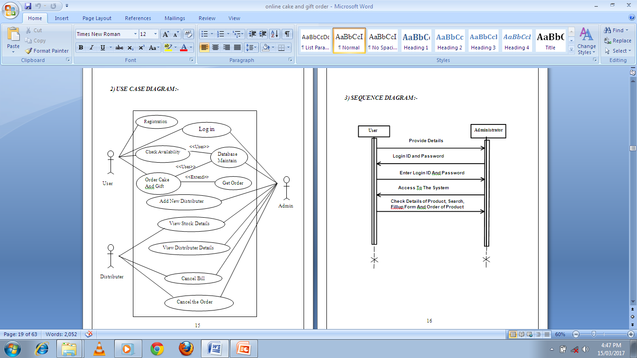
2) USE CASE DIAGRAM:-

Slide 16
3) SEQUENCE DIAGRAM:-
User
Administrator
Provide Details
Login ID and Password
Enter Login ID And Password
Access To The System
Check Details of Product, Search,
Fillup Form And Order of Product

Slide 17
Administrator
Distributer
Send Information of Order
Check Availability
Pay the required amount of Bill
Give the Bill according to cake and gift taken
Cancel the order
Cancel the Bill

Slide 18
User
Distributer
Pay the required amount of Bill
Give the Bill according to cake and gift taken
Pays The Bill
Gives His Order Cake And Gift

Slide 19
4) ACTIVITY DIAGRAM:-
Admin
Login
Invalid
Valid
Add/Edit/
Add/Delete/
Add/Delete/
View
Delete
Edit
Edit
Product Stock
Customer
Distributer
Product
& Distributer
Details
Search for
Product
Yes
No
Give order to
Distributer
Sale the
Product
Give the Bill

Slide 20
User Registration
Login
Invalid
Valid
View
Product
Search for
Product
Yes
No
Fill the form
Buy Product
Order to
Product

Slide 21
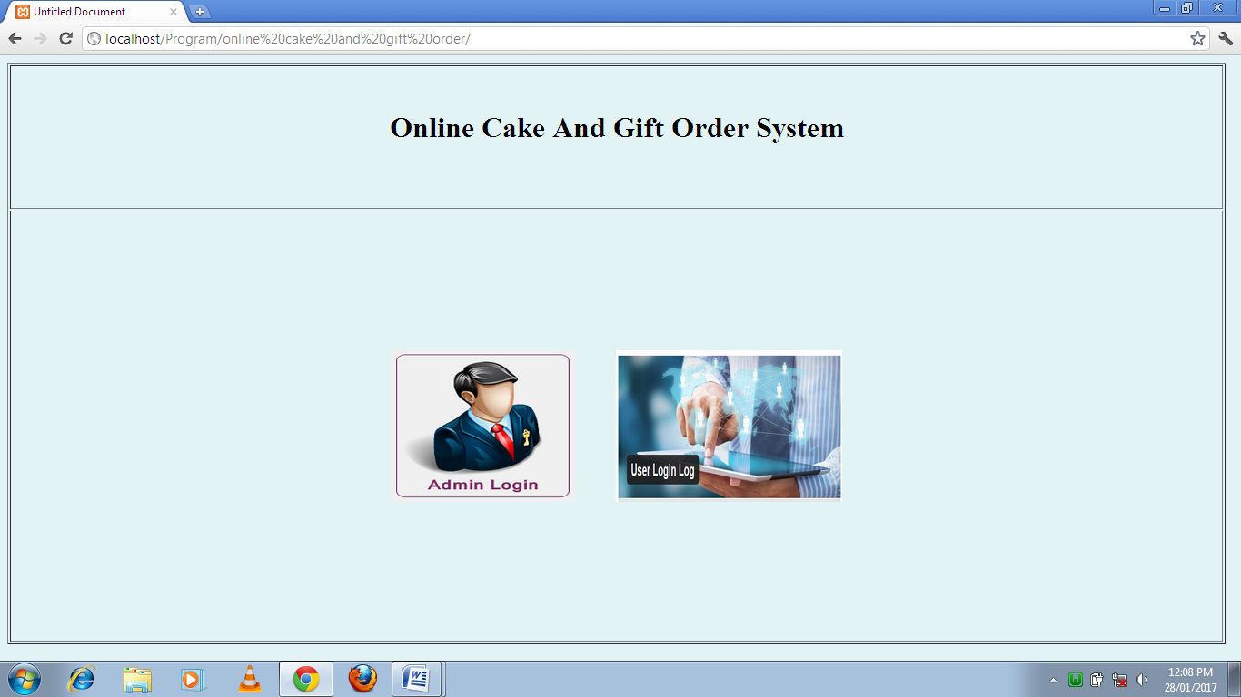
Form Design:-

Slide 22
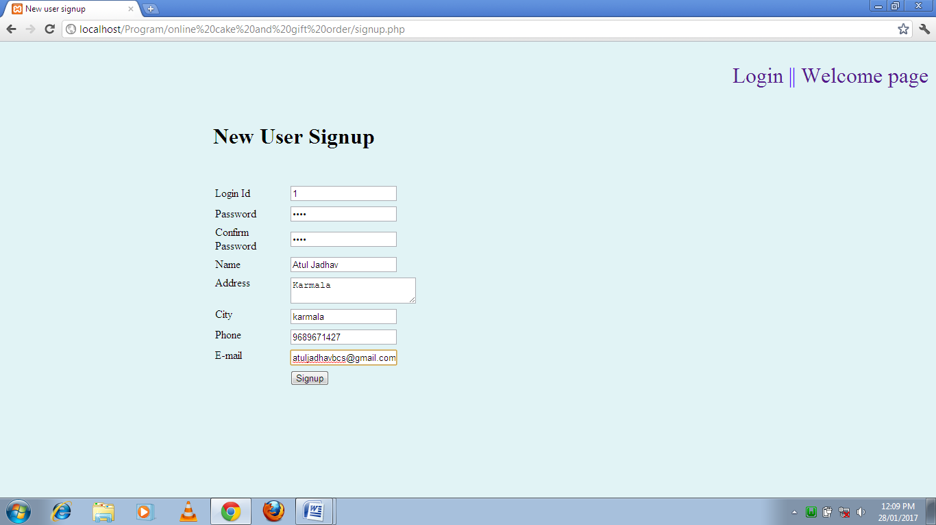
User Registration:-

Slide 23
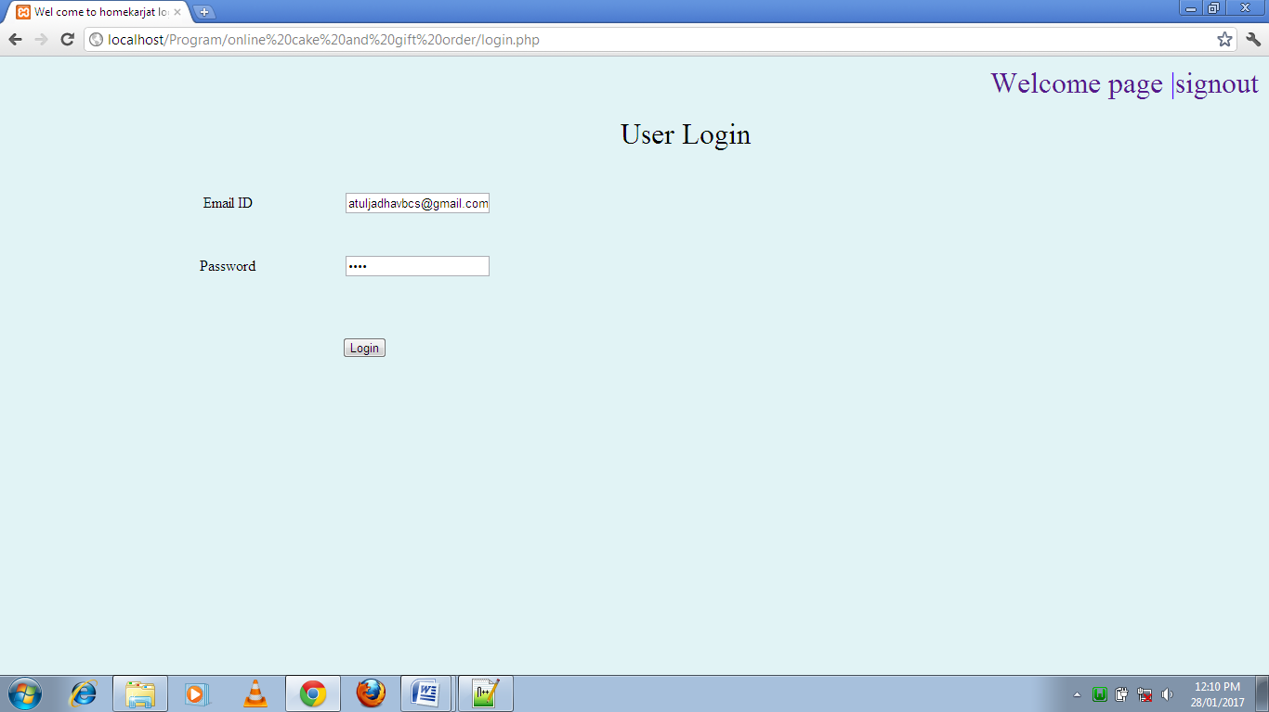
User Login Page:-

Slide 24
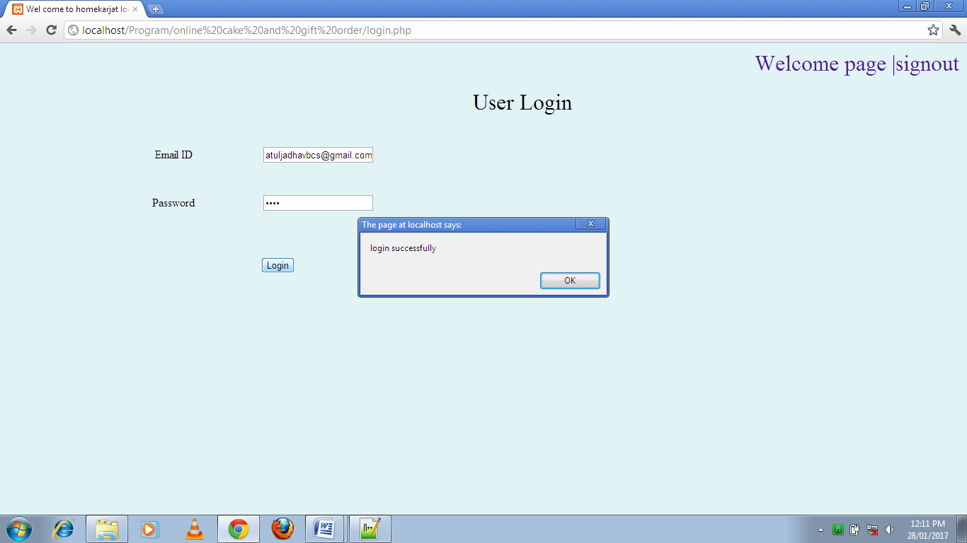
User Login Successfully:-

Slide 25
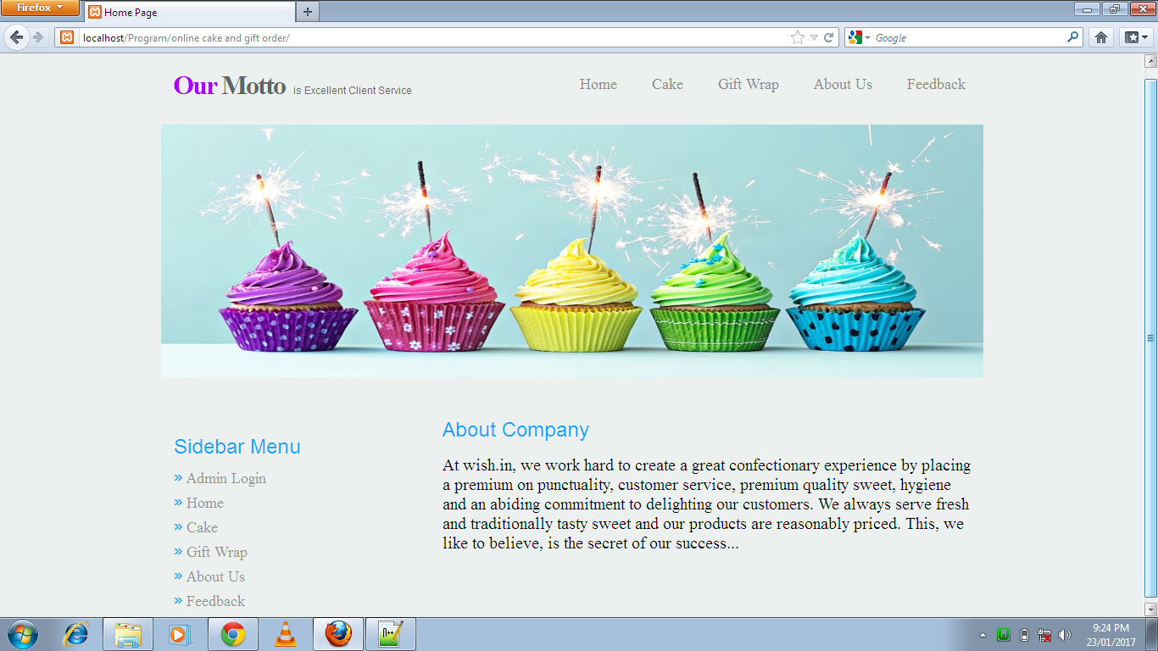
Home Page:-

Slide 26
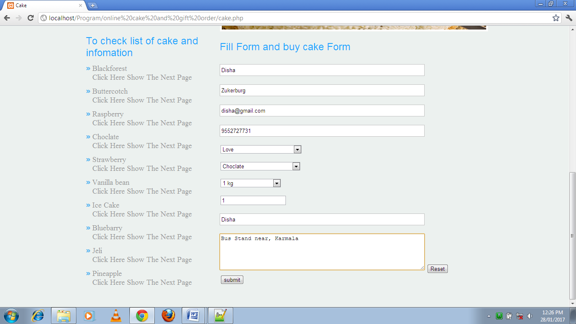
Buy cake form:-

Slide 27
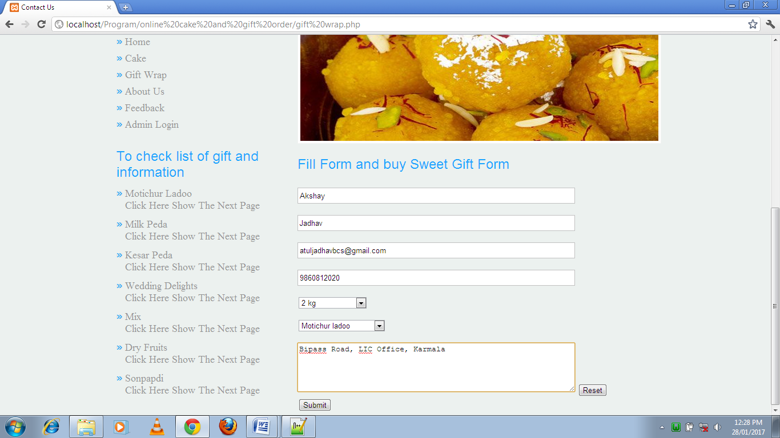
Buy gift form:-

Slide 28
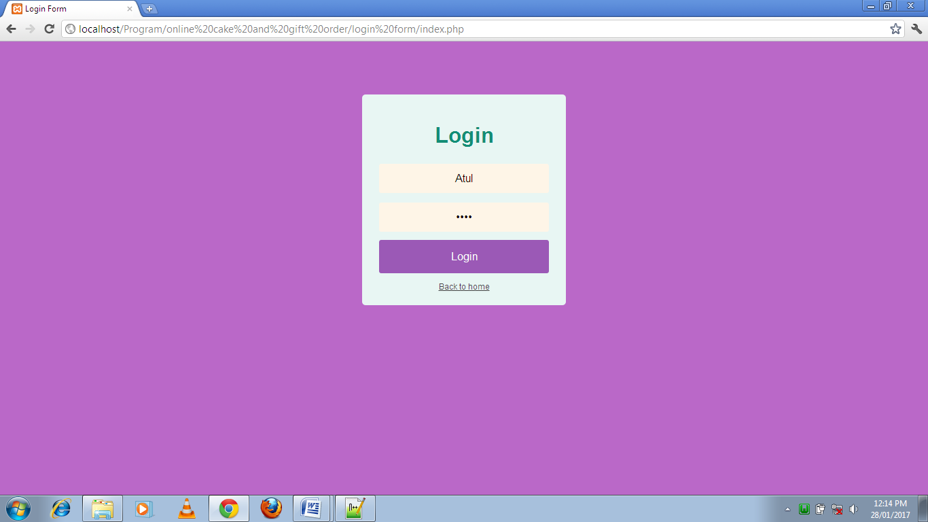
Admin Login:-

Slide 29
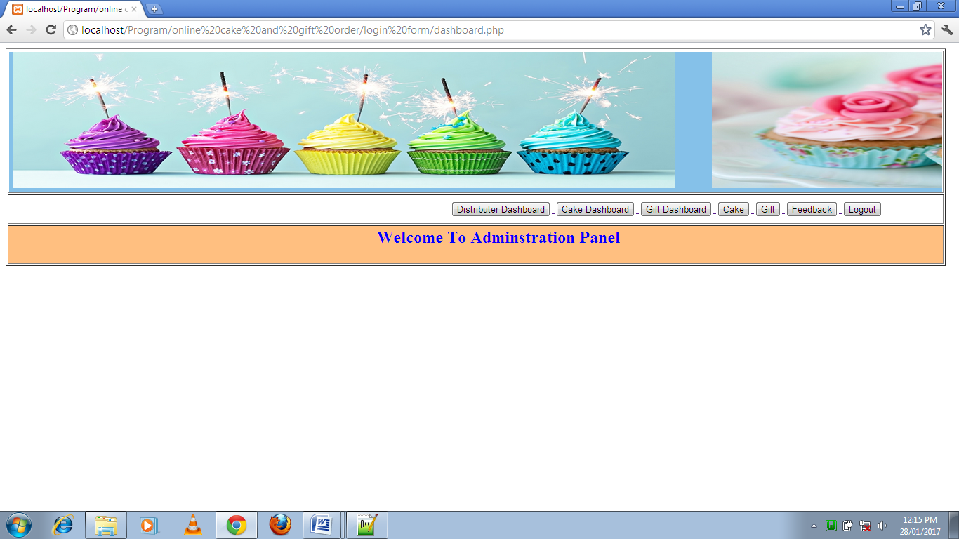
Home Page of Admin:-

Slide 30
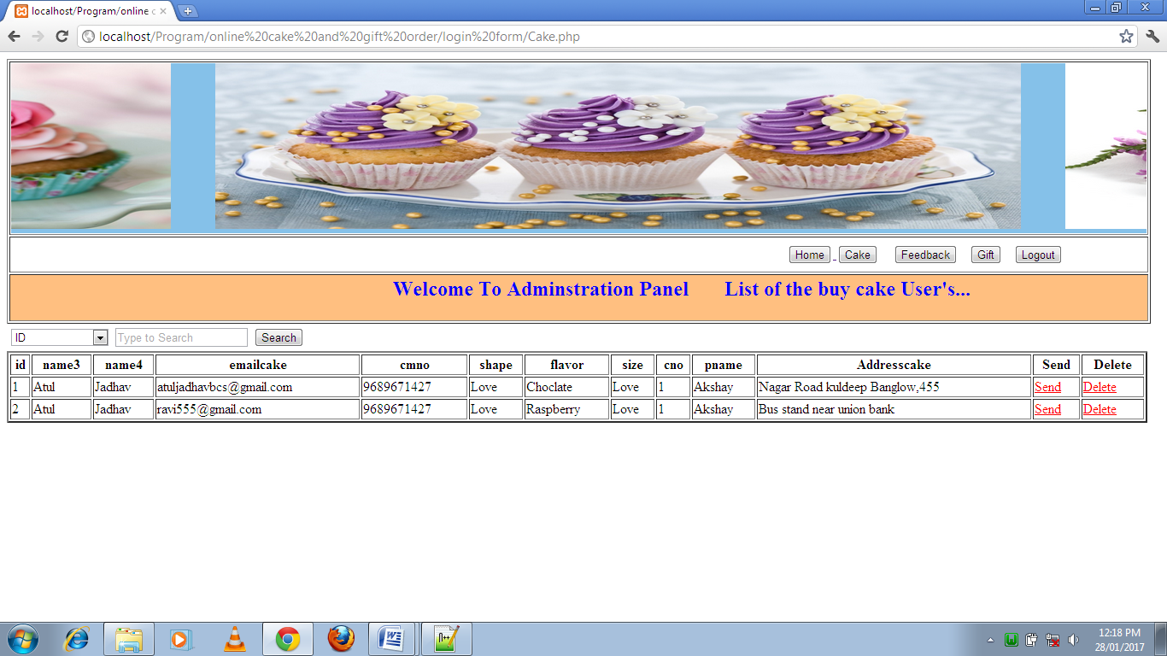
List of the buy cake user:-

Slide 31
LIMITATION:-
It is useful to only small/big city.
Our system is not work for some Amazon, Flipkart so on.
FEATURE ENHANCEMENT:-
We are try to make system for online payment.
We are try to Admin add dynamic cake and gift flavor pages of website.
We are try to the totally dynamic website.

Slide 32


